Slide 1
Collections

Slide 2
What is difference between Array and Collections

Slide 3
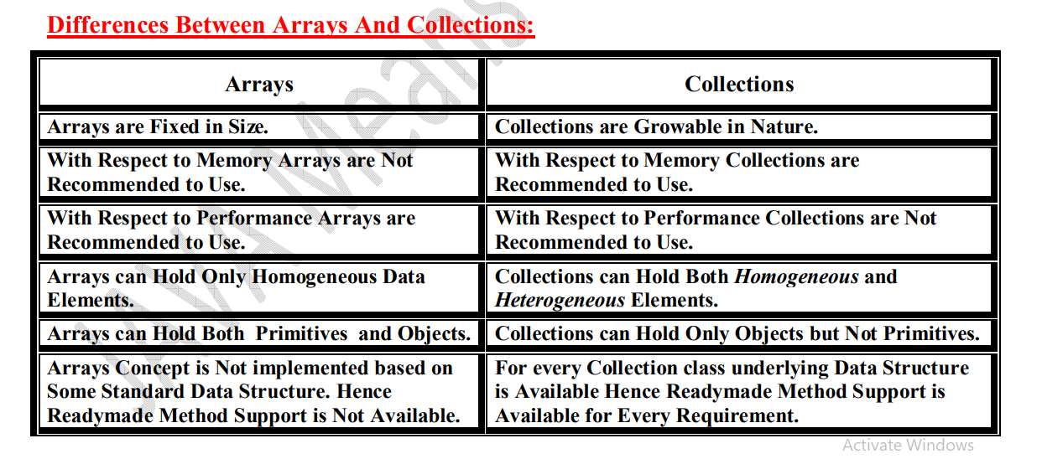

Slide 4
What is collection?

Slide 5
Collection: If we want to Represent a Group of Individual Objects as a Single Entity then we should go for Collection.

Slide 6
Collection Frame Work:

Slide 7
It defines Several Classes and Interfaces which can be used to Represent a Group of Objects as a Single Entity

Slide 8
9 Key Interfaces Of Collection Framework:

Slide 9
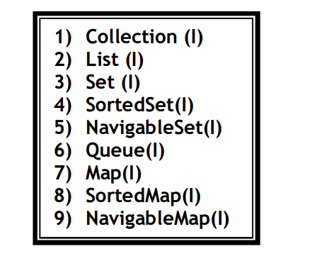

Slide 10
Difference Between Collection (I) and Collections (C):

Slide 11
Collection is an Interface which can be used to Represent a Group of Individual Objects as a Single Entity. •
Whereas Collections is an Utility Class Present in java.util Package to Define Several Utility Methods for Collection Objects

Slide 12
List(I)

Slide 13
List (I): • It is the Child Interface of Collection. • If we want to Represent a Group of Individual Objects as a Single Entity where Duplicates are allowed and Insertion Order Preserved. Then we should go for List.

Slide 14
How many class present in list interface

Slide 15
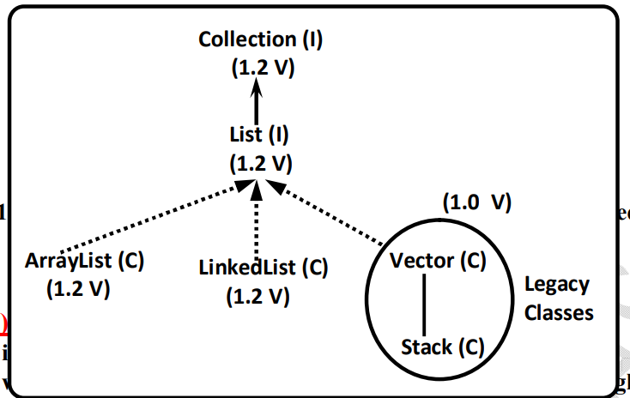

Slide 16
Set(I)

Slide 17
It is the Child Interface of the Collection. • If we want to Represent a Group of Individual Objects as a Single Entity where Duplicates are Not allowed and Insertion Order won't be Preserved. Then we should go for Set Interface

Slide 18
How many class present in set interface

Slide 19
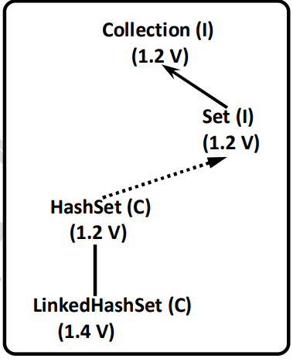

Slide 20
SortedSet (I):
It is the Child Interface of Set. • If we want to Represent a Group of Individual Objects Without Duplicates According to Some Sorting Order then we should go for SortedSet

Slide 21
NavigableSet (I):

Slide 22
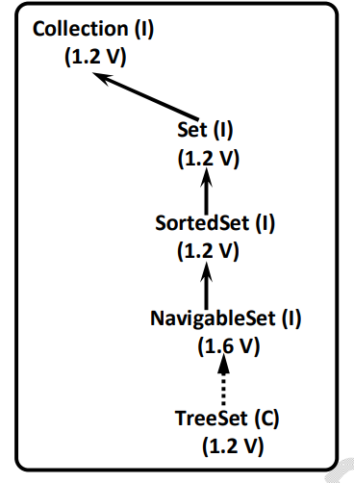
It is the Child Interface of SortedSet. • It defines Several Methods for Navigation Purposes.

Slide 23
Queue (I):

Slide 24
It is the Child Interface of Collection. • If we want to Represent a Group of Individual Objects Prior to Processing then we should go for Queue.

Slide 25
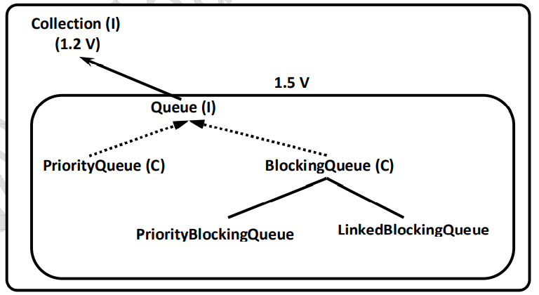

Slide 26
Map (I):

Slide 27
Map is Not Child Interface of Collection. •
If we want to Represent a Group of Objects as Key- Value Pairs then we should go for Map Interface.
• Duplicate Keys are Not allowed but Values can be Duplicated.

Slide 28
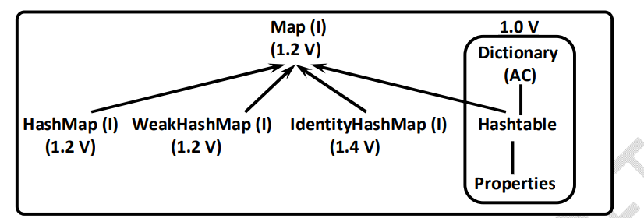

Slide 29
SortedMap (I):

Slide 30
It is the Child Interface of Map. • If we want to Represent a Group of Objects as Key- Value Pairs according to Some Sorting Order of Keys then we should go for SortedMap. • Sorting should be Based on Key but Not Based on Value

Slide 31
NavigableMap (I):

Slide 32
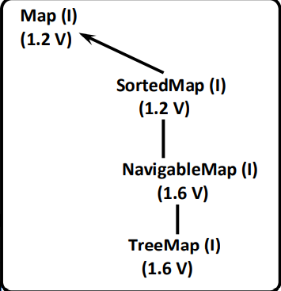
NavigableMap (I): • It is the Child Interface of SortedMap. • It Defines Several Methods for Navigation Purposes

Slide 33
:In Collection Framework the following are Legacy Classes.
1) Enumeration
(I) 2) Dictionary (Abstract Class)
3) Vector (Concrete Class) 4)
4)Stack (Concrete Class)
5) Hash table (Concrete Class)
6) Properties (Concrete Class)

Slide 34
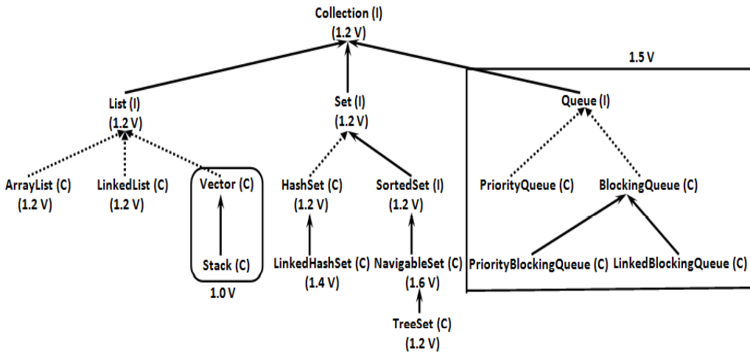

Slide 35
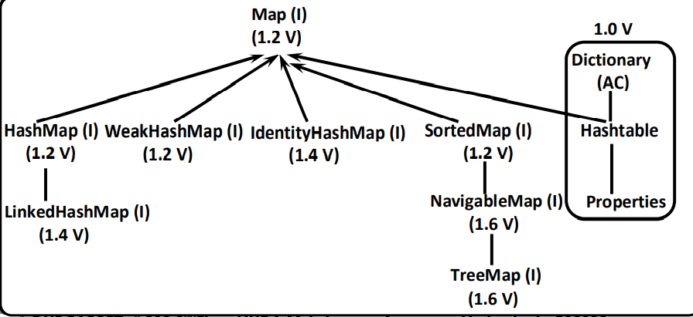

Slide 36
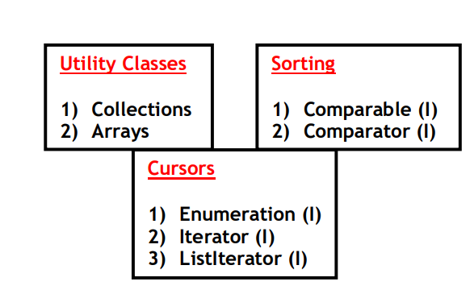

Slide 37
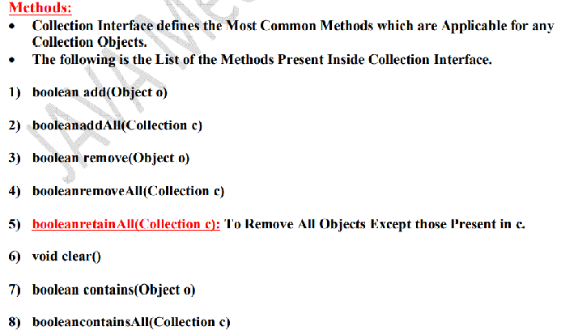
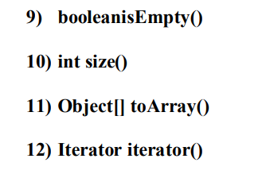

Slide 38
List

Slide 39
List: • It is the Child Interface of Collection. If we want to Represent a Group of Individual Objects where Duplicates are allowed and Insertion Order Preserved.
Then we should go for List. • We can Preserve Insertion Order and we can Differentiate Duplicate Object by using Index. Hence Index will Play Very Important Role in List.

Slide 40
List Methods

Slide 41
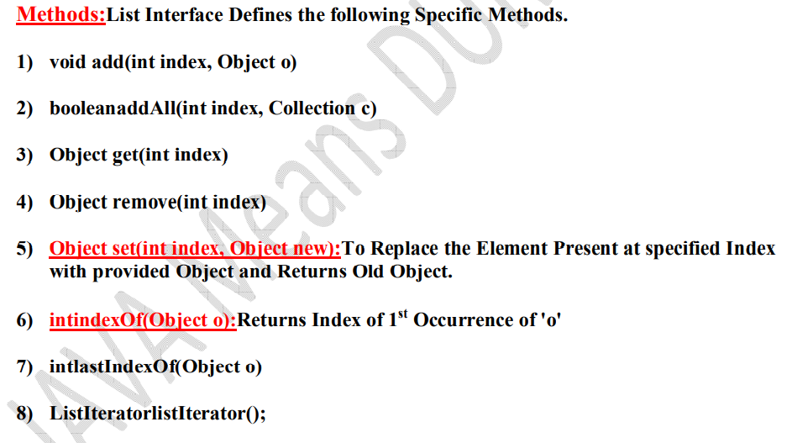

Slide 42
ArrayList

Slide 43
The Underlying Data Structure for ArrayList is Resizable Array ORGrowable Array. • Duplicate Objects are allowed. • Insertion Order is Preserved.
Heterogeneous Objects are allowed (Except TreeSet and TreeMap Everywhere Heterogeneous Objects are allowed). • null Insertion is Possible

Slide 44
ArrayList initial capacity

Slide 45
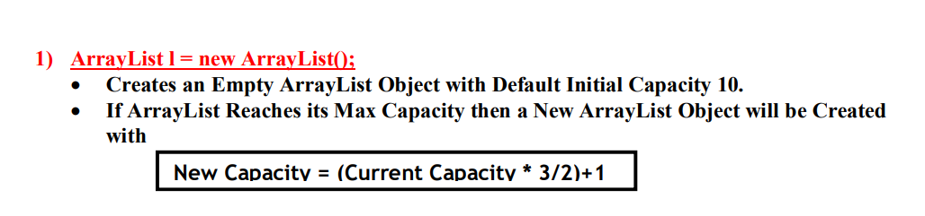

Slide 46
Difference between arraylist and vector

Slide 47
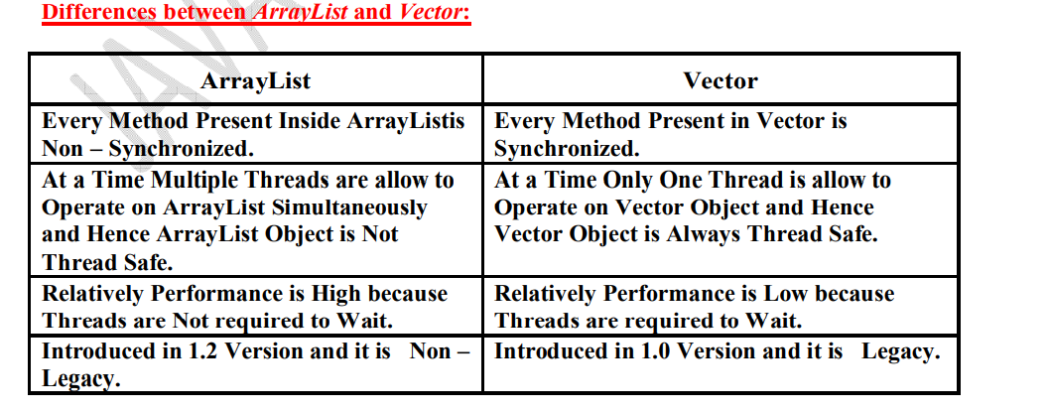

Slide 48
Linked List

Slide 49
LinkedList:
• The Underlying Data Structure is Double LinkedList.
• Insertion Order is Preserved.
• Duplicate Objects are allowed. • Heterogeneous Objects are allowed.
• null Insertion is Possible. •
Implements Serializable and Cloneable Interfaces but Not RandomAccessInterface. • Best Choice if Our Frequent Operation is InsertionOR Deletion in the Middle. • Worst Choice if Our Frequent Operation is Retrieval

Slide 50
The Underlying Data Structure is Hashtable. • Insertion Order is Not Preserved and it isBased on hashCode of the Objects. • Duplicate Objects are Not Allowed. If we are trying to Insert Duplicate Objects then we won't get any Compile Time ORRuntime Error.add() Simply Returns false. • null Insertion is Possible. • Heterogeneous objects are allowed. • HashSet implements Serializable and Cloneable Interfaces but Not RandomAccess. • If Our Frequent Operation is Search Operation, then HashSet is the Best Choice.

Slide 51
